Slide 1
CSS
MCNDHS
Ms. Eng

Slide 2
AIM: SELECTORS – CHILD SELECTOR
Do now:
Daily Grade:
On-time/attendance/not leaving the classroom: 25%
Cellphones: 25%
Notes:25%
Classwork/Homework: 25%

Slide 3
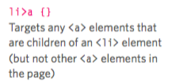
CHILD SELECTOR

Slide 4

DESCENDANT

Slide 5
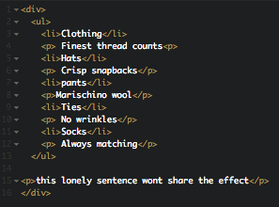
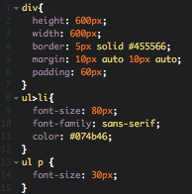
EXAMPLE:

